Slide 1

Codergirl - JavaScript
Class 2
March 10th, 2020

Slide 2

Data and Variables
Housekeeping
Tech Jobs Persistent: DUE TODAY!!
Agenda
Studio review
Conditionals and Debugging
Recap of Exercises
Studio

Slide 3
boolean
Housekeeping
Tech Jobs Persistent: DUE TODAY!!
true or false
NOT True or False and
NOT ‘true’ or ‘false’
let ateDinner = true;
let readyToLearn = true;
let bored = false;
Notes:
Boolean's help us make decisions based on whether some condition is true or false. Here are some examples.

Slide 4
Comparison Operators
Housekeeping
Tech Jobs Persistent: DUE TODAY!!
==
!=
>
<
>=
<=
Notes:
https://education.launchcode.org/intro-to-professional-web-dev/chapters/booleans-and-conditionals/booleans.html#comparison-operators
Here are some comparison operators being used for creating different conditions. We will look at these in our exercises.

Slide 5
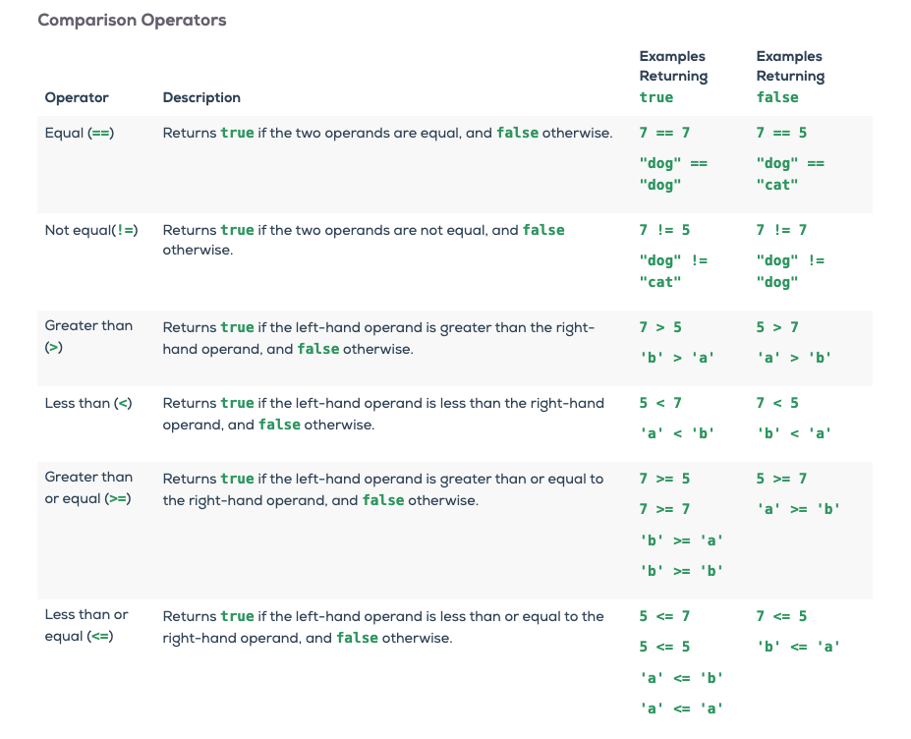
Comparison Operators
Housekeeping
Tech Jobs Persistent: DUE TODAY!!
==
!=
>
<
>=
<=
Notes:
https://education.launchcode.org/intro-to-professional-web-dev/chapters/booleans-and-conditionals/booleans.html#comparison-operators
Here are some comparison operators being used for creating different conditions. We will look at these in our exercises.

Slide 6
Loose/Strict Equality
== versus ===
4 == "4" | true
4 === "4" | false
0 == "" | true
0 === "" | false
Use a === strict equality (or !== strict inequality) comparisons to compare values
and avoid type conversion issues:
Notes:
JavaScript has the concept of loose and strict equality. When we are comparing different types, Javascript does some type conversions to resolve the diff types and that can lead to some unexpected side affects
https://www.sitepoint.com/javascript-truthy-falsy/

Slide 7
Logical Operators
&& || !
homeworkCompleted && choresCompleted
ateFruits || ateVeggies
!misbehaving
Notes:
https://education.launchcode.org/intro-to-professional-web-dev/chapters/booleans-and-conditionals/logical-operators.html
These are used to create compound boolean expressions.

Slide 8
Truth tables for && and ||
For && to be true all conditions should be true
For || to be true any one of the conditions should be true

Slide 9
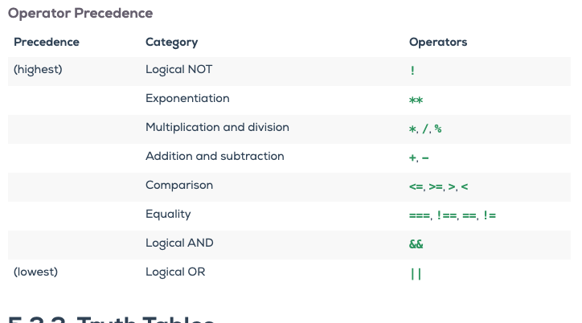

Slide 10
if statements
if(condition) {
do X
}

Slide 11
if else
  if(condition) {
  do X
  } else {
  do Y
  }

Slide 12
if else if
if(condition) {
do X
} else if(condition) {
do Y
}

Slide 13
nested if
if(condition A) {
if(condition B) {
do X
}
}
Notes:
We will demo all these with our exercises.

Slide 14
Errors
Syntax - error during parsing.
Runtime - error during execution.
Logic – unexpected outcome.
Notes:
The moment you start writing code, you will encounter these! They are clues to help you solve what is wrong – why your code isn’t doing what you expect, but it is doing exactly what it’s being told.

Slide 15
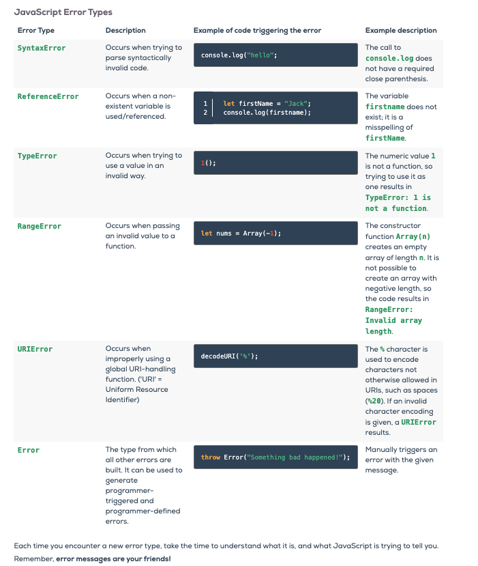
Debugging
Notes:
Doing detective work

Slide 16
Debugging
error messages
console.log
google
Notes:
Doing detective work

Slide 17

Best practices
Tests
Incremental changes
Pairing/Mobbing

Slide 18
Code examples and
exercises
Booleans
Equality
Comparisons
Operators
If
Nested
Syntax, runtime, logic
Exercises 12, exercises 34, exercises 56
Debugging 1,2,3,4,5
Notes:
https://education.launchcode.org/intro-to-professional-web-dev/chapters/booleans-and-conditionals/exercises.html

Slide 19
Graded Assignment # 1 part
https://education.launchcode.org/intro-to-professional-web-dev/assignments/candidateQuiz.html
Notes:
https://education.launchcode.org/intro-to-professional-web-dev/assignments/candidateQuiz.html
18

Slide 20
Questions?

Slide 21
Studio time!
Notes:
https://education.launchcode.org/intro-to-professional-web-dev/chapters/booleans-and-conditionals/studio.html

